Slide 1
Strategic partnerships in the field of medical education with a focus on innovative educational content and greater relevance to the labor market
MEDIC
 | MEDIC - The Attribution-ShareAlike, or CC-BY-SA, license builds upon the CC-BY by requiring that the user license any new products based on the original under identical terms (in addition to crediting the original author).
This project has been funded with support from the European Commission. This publication reflects the views only of the author, and the Commission cannot be held responsible for any use which may be made of the information contained therein.

Slide 2
Avoiding demotivation on the job
Focus:
Avoiding stress
Excerpt of the curricullum

Slide 3
1. Direct lesson ( teacher – students) :
Definition of stress
Different kinds of stress - Definitions
Positive stress – „Eustress“
Negative stress – „Distress“

Slide 4
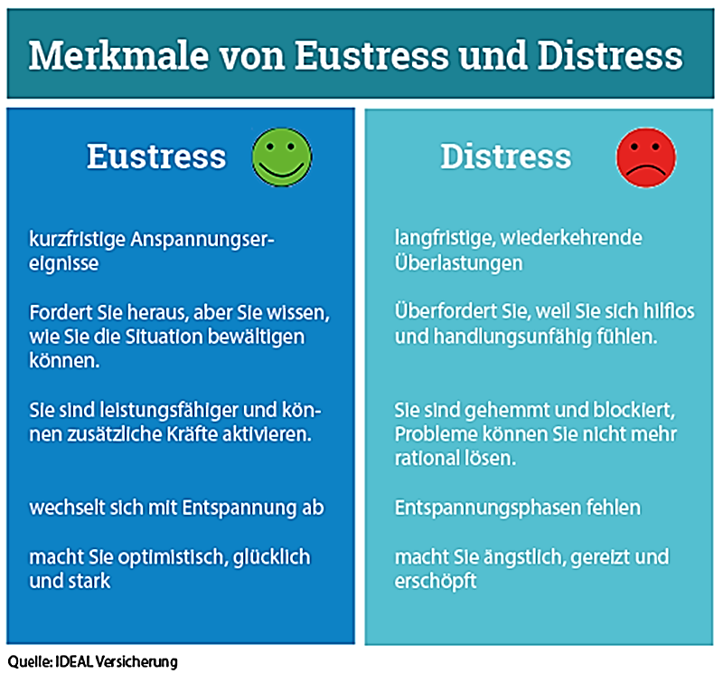

Slide 5
2. Students in self-teaching modus
Find :
External and
internal reasons for stress
Create
examples for „Eustress“ and „Distress“

Slide 6
3. Webinar / online discussion:
Findings :
Reasons for Eustress & Distress
lesson by teacher:
Consequences of permanent distress

Slide 7
Academy of Sports
Target :
Source: Academy of sports

Slide 8
4. homework for students:
Think about your own situations of distress and
write short stories, what you have experienced yourself about it:
when did I have negative stress - distress?

Slide 9
Online – Group discussion and presentation, leade by the teacher
Each student presents his „case – study“
Common discussion about the reasons for the Distress
Common creation of a list a reasons („triggers“) for Distress

Slide 10
Webinar – Online – lesson :
How to detect Distress?
Features of distress
Typical symptoms
Actual - short term
Cronic - permanent

Slide 11
Homework of students: analysis of own triggers and symptoms of Distress
# short term triggers
# long term symptoms
8. Presentation of results in an online-discussion

Slide 12
9. Webinar : How to avoid Distress?
„Outside factors“ – depending on the job – description and expectations
„Inside factors“ :
Empathy
Physical and psychical attributes
Communication – abilities
Know - how

Slide 13
10. Homework of Students
Describe own experienced situations of Distress:
What did you do?
What happened? (result of action)
What shoud have been done?
What could be better?

Slide 14
11. Online Webinar: Transformation from Distress to Eustress
Manual : how to do it?
Analysis of reasons of Distress
Written statements for Eustress & Distress
When and how did it happen?
Memorize Eustress – situations: recall fellings
Transfer this positive feeling to Distress – Situations
Training of this „transfer“!
Apply the Method of „3 x 10“

Slide 15
12. F 2 F lesson:
summary of the curriculum u.t.d.
Questions
Discussion

Slide 16
13. F 2 F – Lesson : Moral Stress in healthcare
Definition of moral stress - moral distress
Reasons of moral stress
Situations of moral stress
Possibilities of solutions
Transparency
Communication
„Integrated“ approach

Slide 17
Homework :Case – studies of Distress / moral stress in healthcare :
Read the case – studies / special healthcare – situations
Find potential solutions
Case studies :
Agnes with too many patients
Communication demand of lonely patients
Nora with a increasing depressive patient

Slide 18
15th to 16th lesson : Webinar
Students present their solutions for the case studies
Discusion about the
pros and
cons of the solutions
Common work to find „optimal solutions“

Slide 19
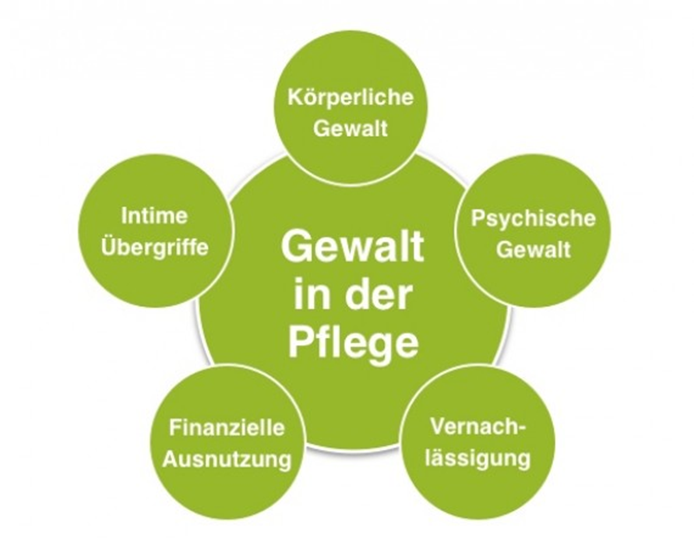
17. Webinar: Violence in healthcare : a special source of distress
Source: pflege.de

Slide 20
Physical violence
Psychological violence
Sexual assaults
Financial abuse
Physical or psychological neglect

Slide 21
Definition of different kinds of violence
Violence by the caretaker
Violence by the patient
Examples
Solutions

Slide 22
F 2 F – Lesson
Summary of the curriculum „ Avoiding stress“
Questions of students
Discussion
Preparation of test – questions
Total time: approx. 40 hours

Slide 23
Thank you for your attention
Veronika Stenzel
Christian Hemerka

